Slide 1
Setup your AWS .NET Environment and get Deploying
KCDC Workshop Session

Slide 2

About me
Lead the technology and engineering teams at Headspring.
More than 18 years’ experience developing software, managing teams, connecting people within organizations and whispering.
Experience in architecture, cloud, devops, and everything in between. I may not know the answer, but I’ll know how to find it.
Am actually pretty terrible at ping pong.
Houston .NET Users Group, TEALS Volunteer
Bachelor’s degree in Computer Science and MBA from University of Houston (Go Coogs!)
Garo Yeriazarian
https://www.garoyeri.dev
Software Whisperer
(and Principal Consultant)
https://twitter.com/garoyeri

Slide 3

About me
Technical lead on Headspring’s development projects, people manager, and functional programming advocate.
Specializing in DevOps, cloud application development, and modernizing legacy applications with a delight in making lives easier for both clients and their customers.
Host of Headspring podcast OK Human
🥾 ⛺ 🎶 🏊‍♂️ 🎨 🍻
Bachelor’s degree in Game Design and Development from Rochester Institute of Technology
Patrick McVeety-Mill
https://loudandabrasive.com
Principal Consultant
@loudandabrasive

Slide 4


Applications
Software consulting and development
Building better software
to propel businesses into the future
Microservices
We make it
#missionpossible
Cloud & DevOps
Data Architecture
Legacy Modernization
Notes:
I’m at Headspring, a software consulting and development firm delivering solutions from application development to architectural strategy to legacy system transformation
We are a titanium sponsor
Stop by our booth
We’re hiring! See how we make both career growth and our client’s goals mission possible

Slide 5
Workshop Agenda (4 hours of AWS and .NET fun!)
Hour 1
Review the Agenda
Icebreaker / Getting to know you
Make sure you’ve got everything setup
LAB: Securing your AWS Account
LAB: Setup DNS for your AWS Account
Q&A
BREAK
Hour 2
AWS Structures and Endpoints
LAB: ASP.NET Core Hello Lambda
Mental Model for the Cloud
Q&A
BREAK
Hour 3
AWS IAM (Requests and Identity)
LAB: ASP.NET Core DynamoDB
LAB: And now on Fargate
Q&A
BREAK
Hour 4
VPCs and Networking
LAB: Relational Database Madness (Lambda and Fargate)
Q&A
Wrap-Up (Clean up your AWS Accounts)
Time Permitting: AMA

Slide 6
Break the Ice!

Slide 7
Do you have everything installed to continue?
Just a quick check! You need at least the following to have a fun time:
Node JS: https://nodejs.org/en/
.NET Core SDK 5: https://dotnet.microsoft.com/download/dotnet/5.0
.NET Core SDK 3.1: https://dotnet.microsoft.com/download/dotnet/3.1
AWS CLI v2: https://docs.aws.amazon.com/cli/latest/userguide/install-cliv2.html
Docker Desktop: https://www.docker.com/products/docker-desktop (personal / free tier will work just fine)
Git: https://git-scm.com
If you still don’t have an AWS Account, GET ONE CREATED NOW!

Slide 8
Securing your AWS Account

Slide 9
Cost Predictability
Problems
AWS will charge you for what you use (knowingly or unknowingly)
AWS will not warn you (by default) that you left something expensive running
Even though you may have the promise of “Free” tier in your hand, AWS still has your credit card number and not all things are free
Solutions
Setup a Budget Alert (link)
Enable Cost Explorer (link)
When AWS sends you an alert, act on it

Slide 10
Listen to AWS when it says “don’t use your Root account”
Problems
Your “root” account login (the email you signed up for AWS with) is the last line of defense for your account in case of disaster
AWS gives you a VERY hard time with some super ugly captchas if you try to use your “root” account (hint hint)
Solutions
Ensure that MFA is turned on for your root account (link)
Create a console IAM user with all the administrative privileges and budget / billing access (link)
Login with the new console user
Ensure that MFA is turned on for your console user

Slide 11
Setup CLI Access
Problems
Now that you have access to the AWS Console, you’ll need CLI access as well
Solutions
Create a new Access Key for your Console user (link)
Setup a local AWS CLI profile (link) as your default profile (or a named profile)

Slide 12
Checkpoint: Test out your new superpowers
Open your favorite Terminal application
Run a command on the AWS CLI: aws sts get-caller-identity
if you created a named profile instead of “default”, then append: --profile your-profile-name
You’ll see your user account details (nothing secret) { "UserId": "AIDAVLCCOJS2CWLYZ632O", "Account": "367359052980", "Arn": "arn:aws:iam::367359052980:user/cli-user-hs718" }

Slide 13
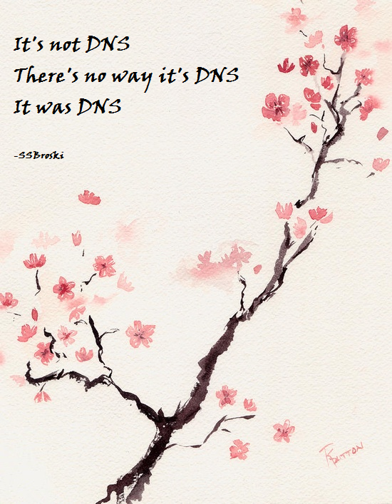
DNS
https://i.imgur.com/eAwdKEC.png

Slide 14
Lab: Setup DNS for the Workshop (~30 min)
Problems
We’ll be deploying some services to AWS, but they’ll have terrible, random names
If you want to show off your cool workshop work to all your friends, you’ll need to tell them the URL (or text it to them).
You may not have a classy domain name like garoyeri.dev
Solutions
AWS Route 53 is cheap (link) and provides DNS capabilities. You can create public certificates for free
We’ve got an automation to get you setup
If you don’t have a domain handy, I’ll get you hooked up on (yourname).kcdc.garolabs.com

Slide 15
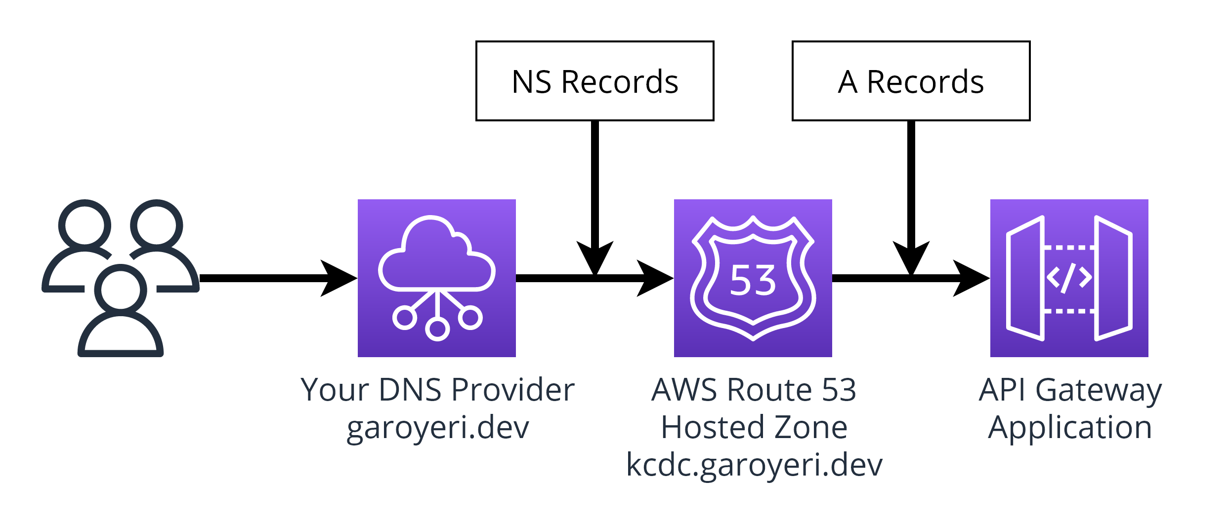
Lab: Setup DNS for the Workshop (~30 min)
Instructions
Clone Repository: https://github.com/garoyeri/aws-dotnet-workshop
View the instructions on GitHub (README.md)
Click the link for “Workshop 00: Deploying DNS” (link)
Deploy the CDK stack as per instructions, then update your DNS provider settings

Slide 16
Q&A

Slide 17
Let’s take a break!
Back at ##:##

Slide 18
AWS Structures and Endpoints

Slide 19
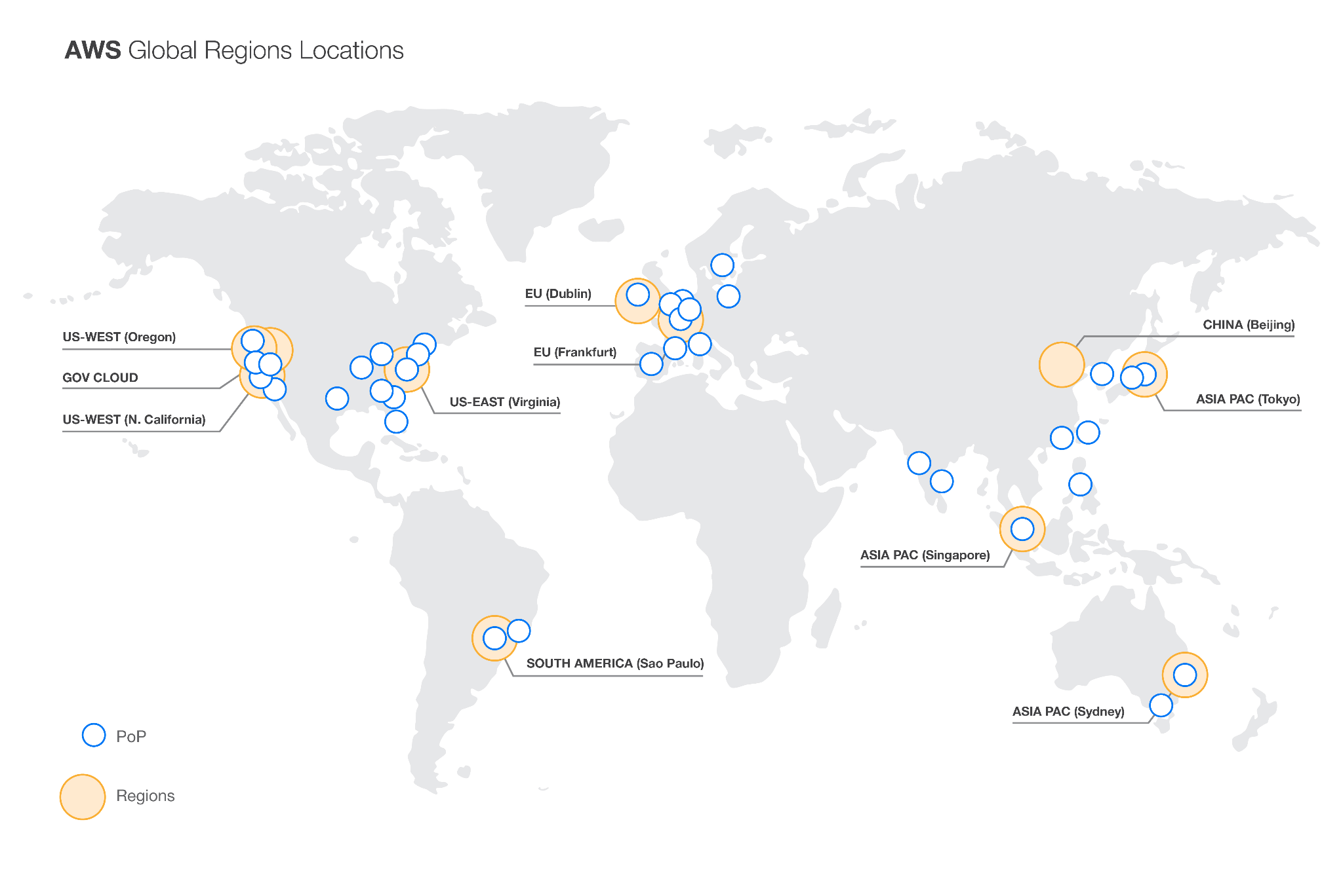
AWS Regions

Slide 20
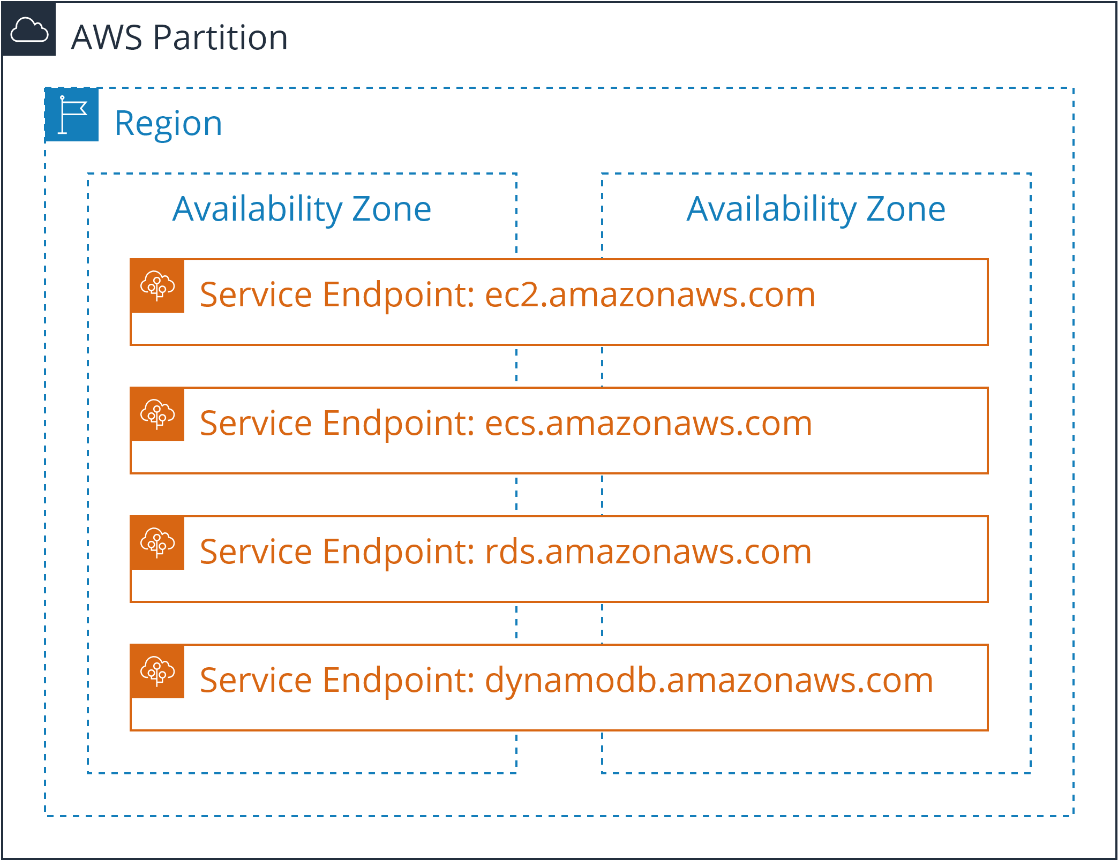
Partitions, Regions, Availability Zones, Endpoints

Slide 21
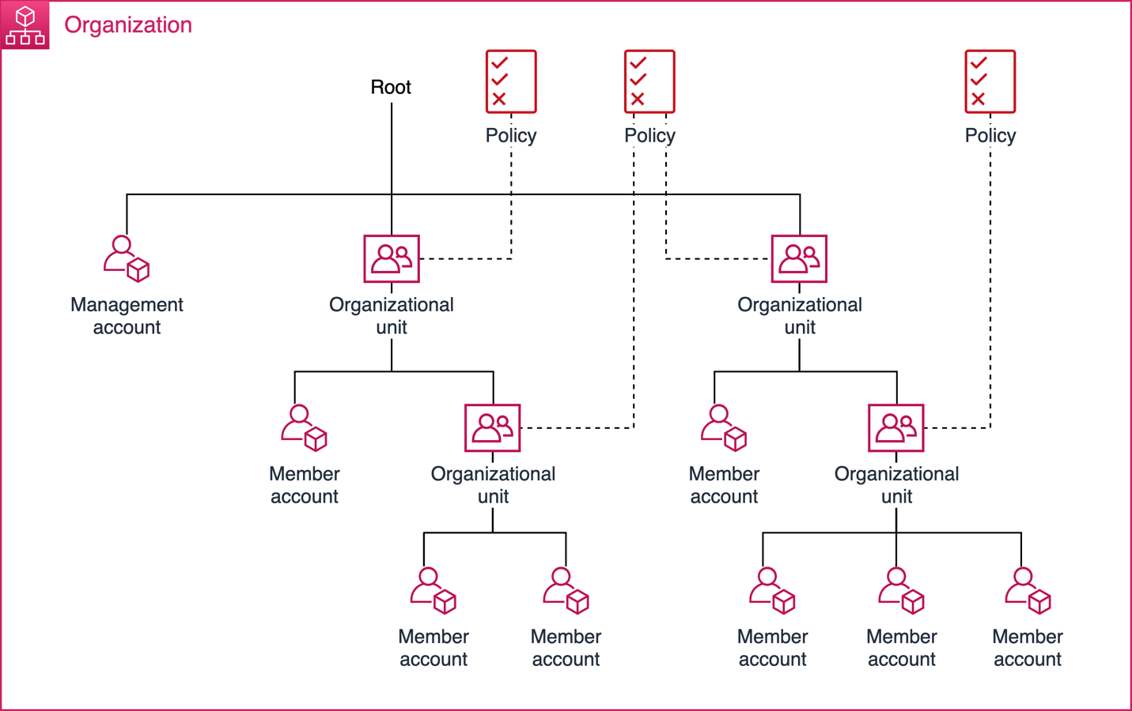
AWS Accounts and Organizations
https://docs.aws.amazon.com/whitepapers/latest/organizing-your-aws-environment/core-concepts.html

Slide 22
Jeff Bezos’ AWS API Mandate (Summarized)
All teams will henceforth expose their data and functionality through service interfaces.
Teams must communicate with each other through these interfaces.
There will be no other form of inter-process communication allowed.
It doesn’t matter what technology they use.
All service interfaces, without exception, must be designed from the ground up to be externalizable. No exceptions.
Anyone who doesn’t do this will be fired. Thank you; have a nice day!

Slide 23
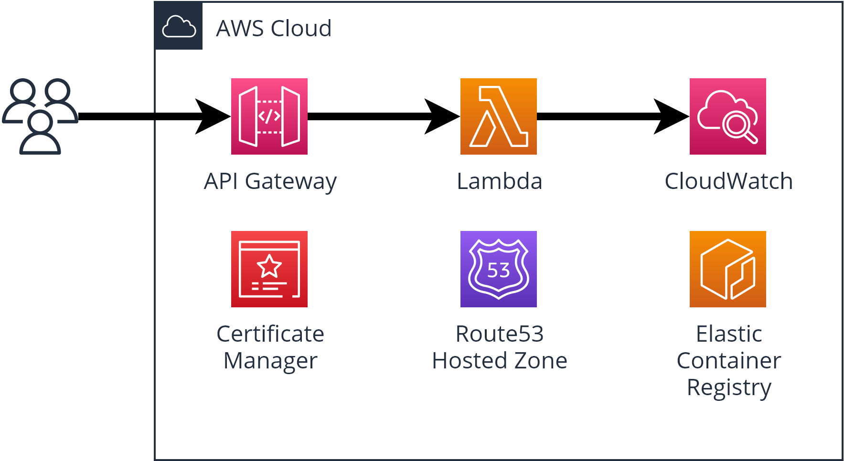
Lab: Hello World ASP.NET Core (~30 min)
Instructions
See the README instructions for Workshop 01
Checkout branch
Deploy the application
Let’s explore the parts of the application together

Slide 24
Mental Model for the Cloud

Slide 25
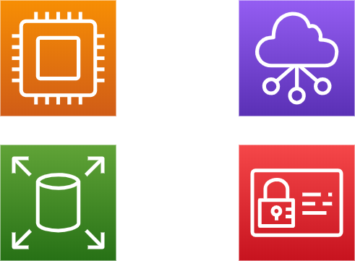
Mental Model for AWS (and Cloud)
Compute
Network
Storage
Permissions

Slide 26

Compute

Slide 27
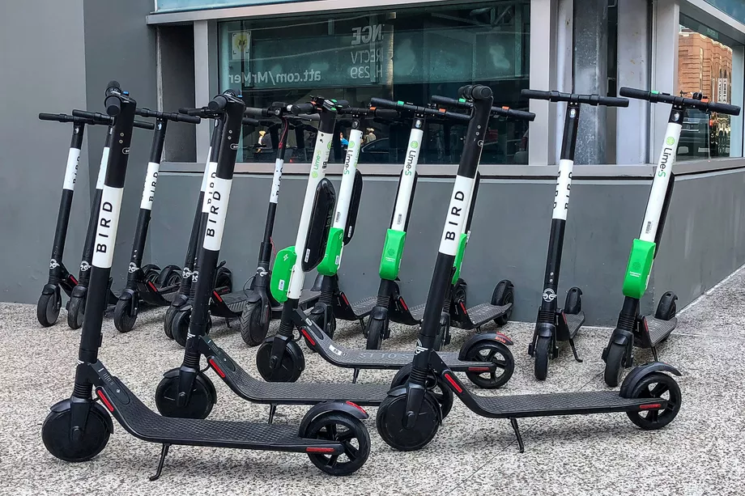
Compute: Rented Transportation
Pay more to go faster or to share less.
Use more instances of cheaper compute to get the job done (scale out)
The scourge of the urban streets. Source: https://www.theverge.com/2018/8/1/17634330/bird-electric-scooter-sharing-paris-tel-aviv

Slide 28
Compute: Borrowed Time
Someone Else’s
CPU Time
Your Allocated
CPU Time
Processor

Slide 29

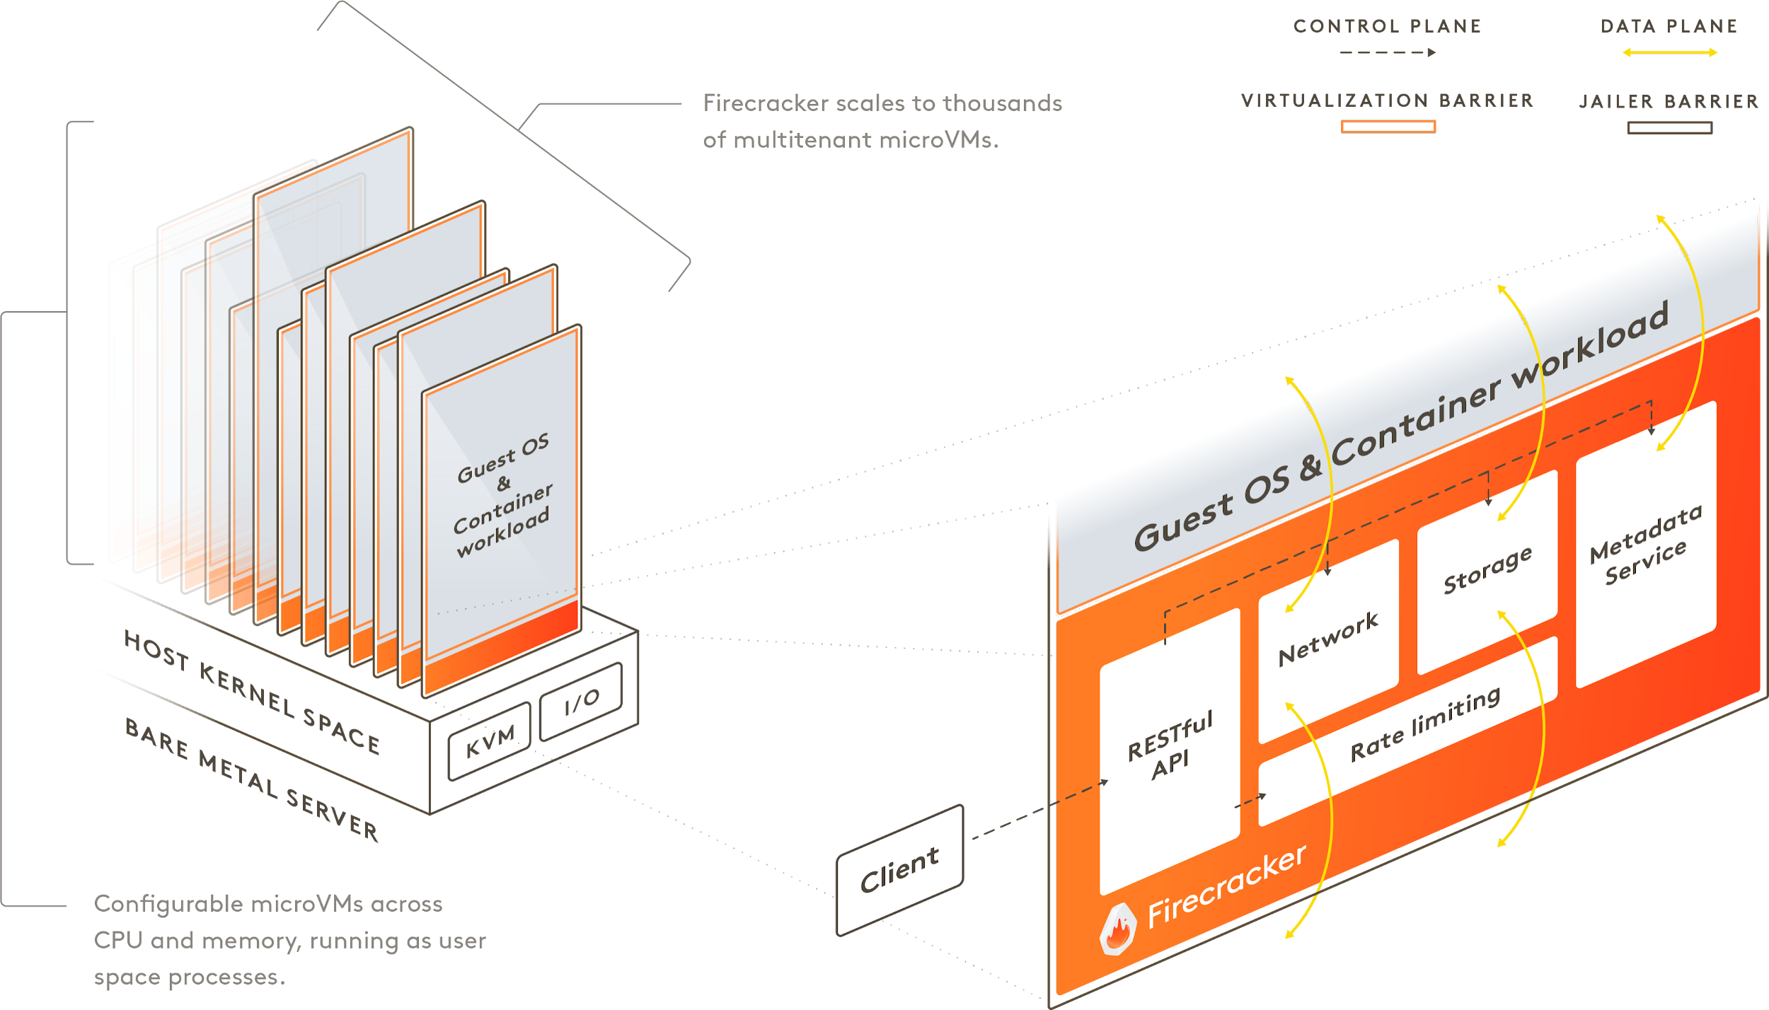
https://firecracker-microvm.github.io/

Slide 30
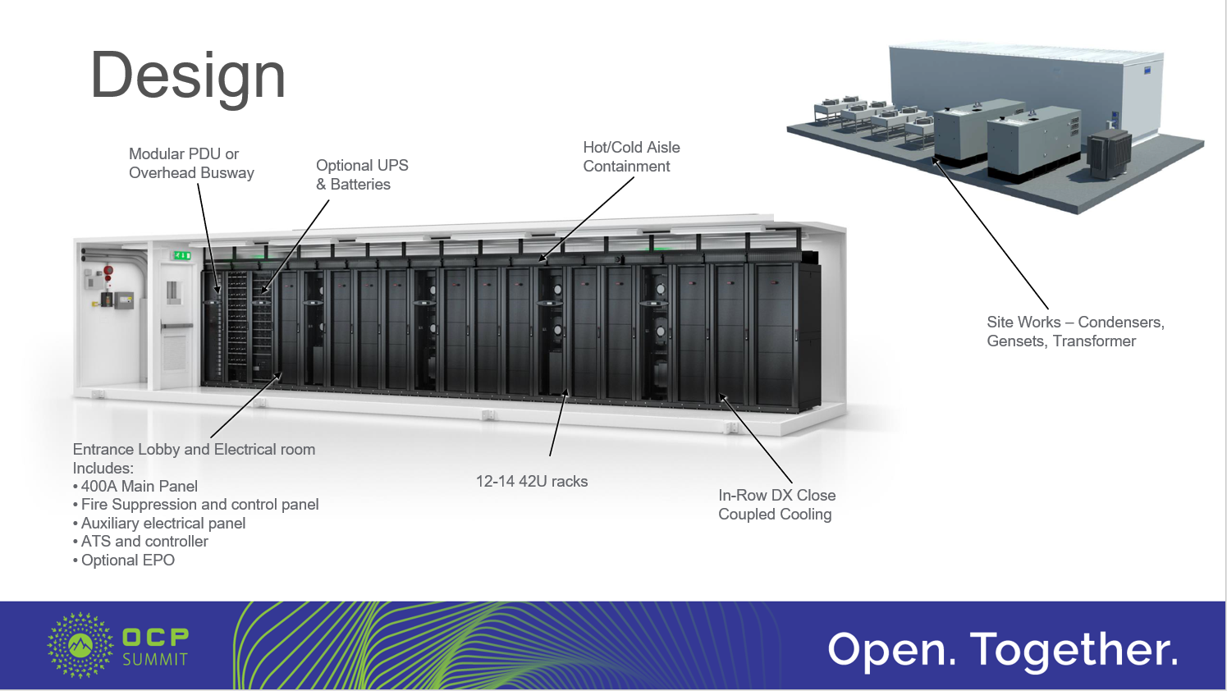
Compute: Datacenter Design

Slide 31
Compute
Most expensive part of your cloud bill
Shared processor time
Allocated as Cores + RAM
Scale Out instead of Up

Slide 32

Storage

Slide 33
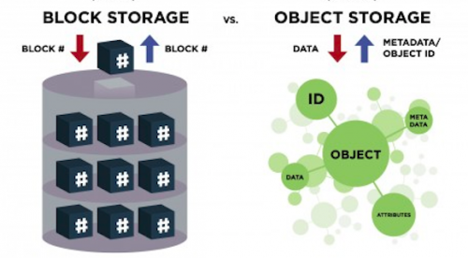
Storage: Blocks or Blobs
Blocks are evenly sized, ordered, raw data storage
Blobs are any size, key based, single-object storage
Object Storage versus Block Storage: Understanding the Technology Differences: https://www.druva.com/blog/object-storage-versus-block-storage-understanding-technology-differences/

Slide 34
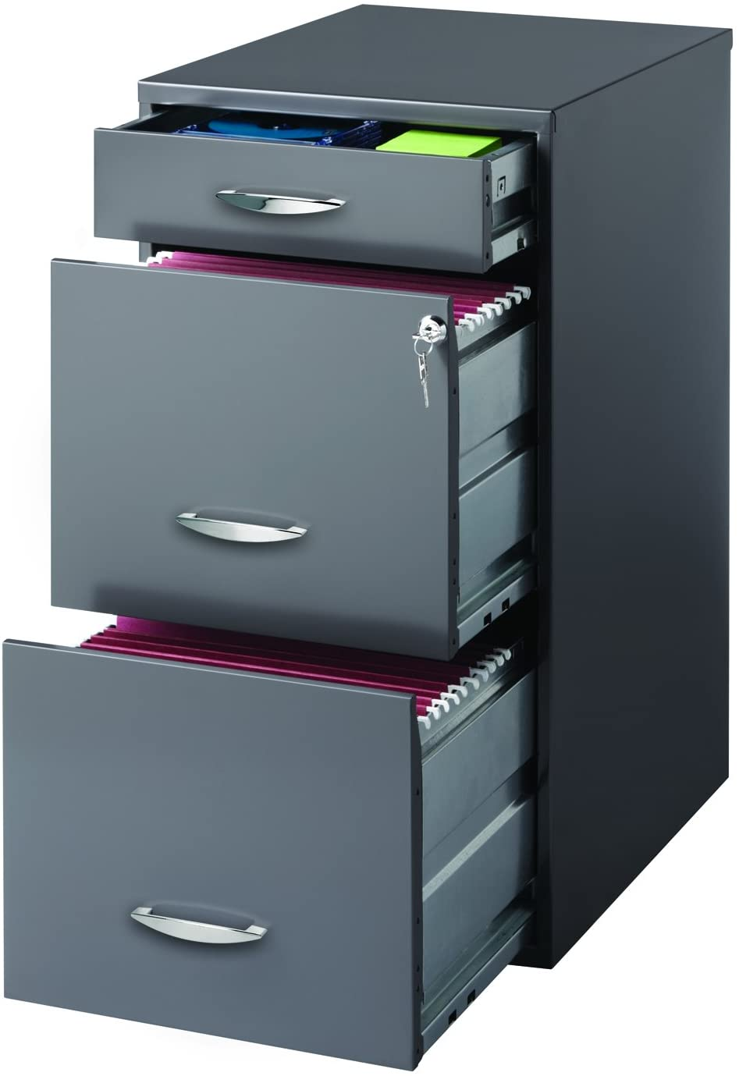
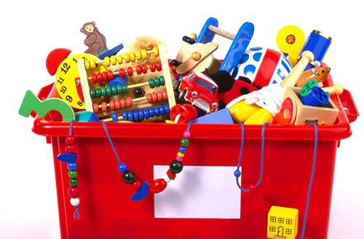
Storage: Access Patterns
Ordered, organized, rapid access
Random selection
Hirsh SOHO 3 Drawer File Cabinet in Charcoal: https://www.amazon.com/Hirsh-SOHO-Drawer-Cabinet-Charcoal/dp/B01ASUWBQM
Is Your Toy Box Half Full or Half Empty? https://globaltoynews.com/2014/02/05/is-your-toy-box-half-full-or-half-empty/

Slide 35
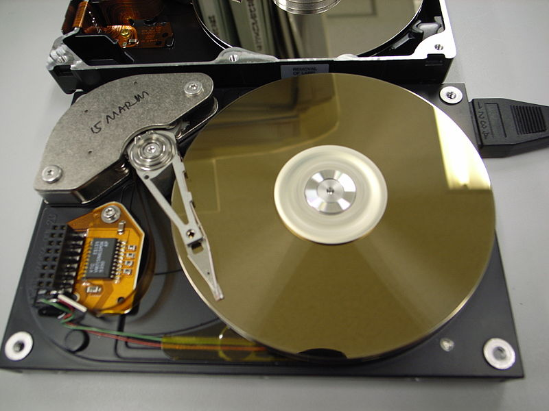

Storage: Block Storage Classes
Spinning Disks
Solid State
"Hard Disk (opened)" by Toshiyuki IMAI is licensed under CC BY-SA 2.0. “Clip Art of the Flash” CC0 Public Domain: https://pixy.org/4649350/

Slide 36

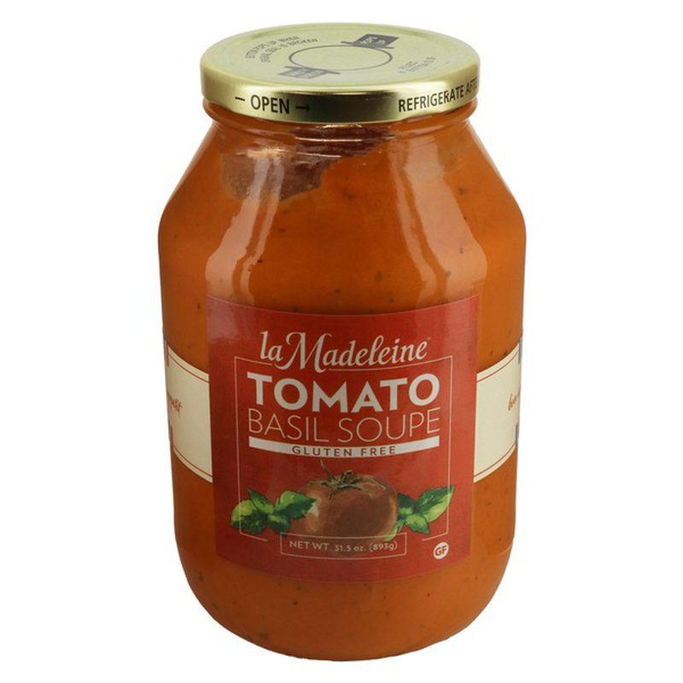
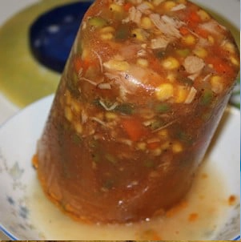
Storage: Blob Storage Classes
Hot
Cold
Frozen
How to Make Tomato Soup with Fresh Tomatoes: https://www.yummymummykitchen.com/2017/08/how-to-make-tomato-soup-with-fresh-tomatoes.html
La Madeleine Soup, Tomato Basil, Jar: https://www.instacart.com/landing?product_id=16265762&retailer_id=45&region_id=10154461670&mrid=309941600
Yoshon Soups, Frozen: https://yoshon.com/product-category/soups/

Slide 37
Storage
Storage is cheap
Block or Blob (usually Blob)
Storage classes: Hot, Cold, Fast, Slow

Slide 38

Network

Slide 39
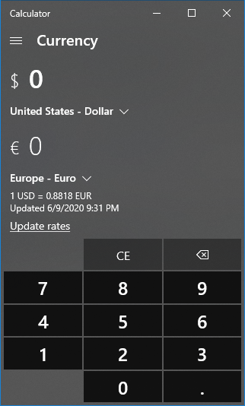
Nework: Every Software Uses It
Modern software requires networking
(even Calculator)
Screenshot of Windows Calculator needing network access

Slide 40
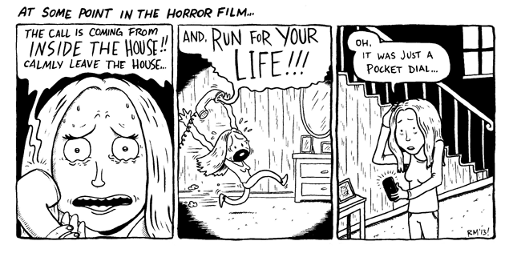
Nework: Cloud API Calls
Cloud API calls are HTTPS requests
Created by Robb Mirsky: https://robbmirsky.wordpress.com/2013/05/07/the-call-is-coming-from/

Slide 41
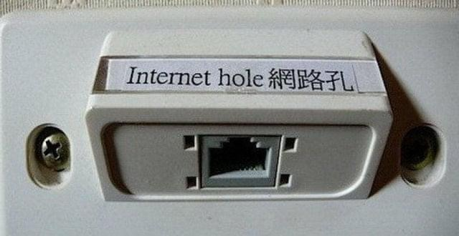
Nework: Isolation
“Public Cloud” means shared network traffic
Use Virtual Private Cloud (VPC) to isolate and route traffic
Always use secure protocols
The hole where the Internet comes out. It’s safe. Trust me.

Slide 42
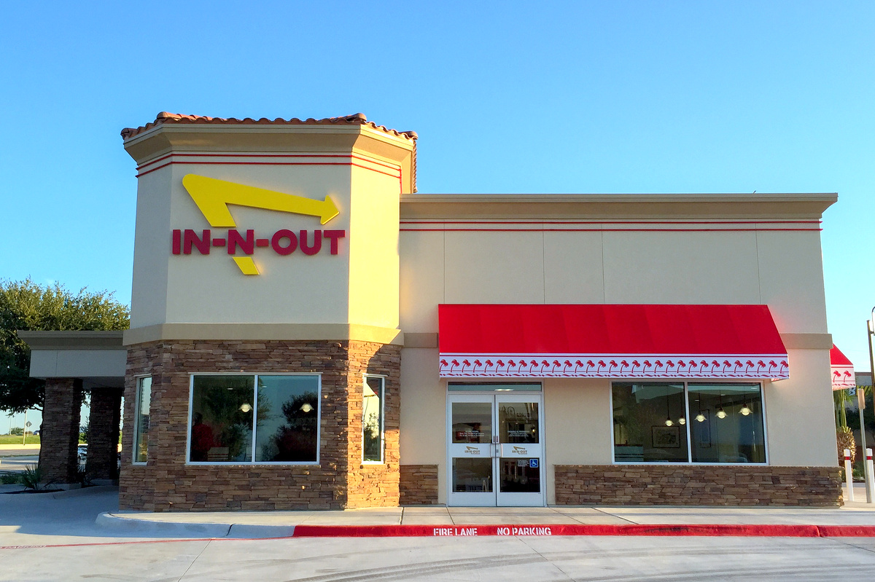
Nework: Egress and Ingress
Typically billed for egress (outbound traffic)
Ingress (inbound traffic) becomes storage
Different types of egress:
Availability Zone
Region
Internet
I honestly don’t know why this is popular. https://communityimpact.com/austin/northwest-austin/dining/2016/09/15/3-things-know-n-burgers-new-north-austin-location/

Slide 43
Network
Billed for egress
VPC for network isolation
How is traffic routed: public or private networks?

Slide 44

Permissions

Slide 45

Permissions: Feelings of Mutual Distrust
Caller must have permission to request API call to Resource
Resource must allow API call from Caller
But if you find the golden access key, I’ll hand you the Chocolate Factory.

Slide 46

AWS Services Permissions
“Circle” of Trust!
Caller Permissions
Callee Permissions
Lambda
Role
Permission
S3

Slide 47
Permissions: Amazon Resource Names (ARN)
arn:partition :service :region :account-id :resource-id
arn:partition :service :region :account-id :resource-type/resource-id
arn:partition :service :region :account-id :resource-type:resource-id
arn:aws :s3 :us-east-1 :123456789012:my_corporate_bucket/Develop/file
arn:aws-cn :lambda :eu-west-1 :123456789012:function:my-function:1
arn:aws-us-gov:iam : :123456789012:role/S3Access
https://docs.aws.amazon.com/general/latest/gr/aws-arns-and-namespaces.html
There’s nothing funny about ARNs, sorry. I don’t have any jokes for these … yet.

Slide 48
Permissions
Look for Role and Permission settings
Follow the principle of least privilege
ARNs are universal identifiers in AWS

Slide 49
Serverless Core Components
Compute
Network
Storage
Permissions

Slide 50
Q&A

Slide 51
Let’s take a break!
Back at ##:##

Slide 52
AWS Identity and Access
Management (IAM)

Slide 53
AWS IAM: How it works
“Circle” of Trust!
Caller Permissions
Callee Permissions
Lambda
Role
Permission
S3

Slide 54
AWS IAM: How it works
Role is established by
Explicit Access Key credentials
Assumed role
Resource assigned role
Role Policies define what API calls can be made to which resources
Permissions are established by
Policies assigned to resource

Slide 55
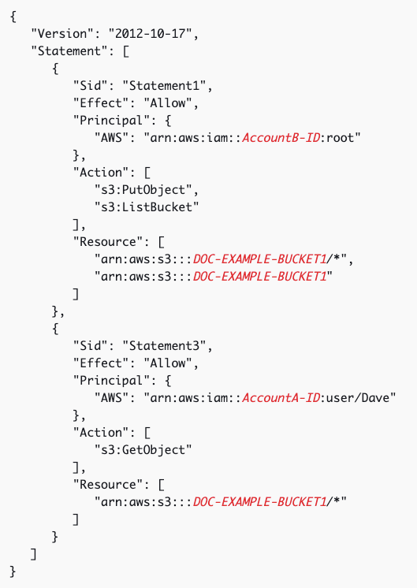
AWS IAM: How it works
{
"Version": "2012-10-17",
"Statement": [
{
"Sid": "Statement1",
"Action": [
"s3:GetObject",
"s3:ListBucket",
"s3:PutObject"
],
"Effect": "Allow",
"Resource": [
"arn:aws:s3:::DOC-EXAMPLE-BUCKET1",
"arn:aws:s3:::DOC-EXAMPLE-BUCKET1/*"
]
}
]
}

Slide 56
AWS IAM: How it works
Principals can be (link)
Any role from a particular AWS account: arn:aws:iam::555555555555:root
Individual IAM User: arn:aws:iam::555555555555:user/user-name
IAM Role: arn:aws:iam::555555555555:role/role-name
AWS Service: ecs.amazonaws.com
Public: * (very not recommended)

Slide 57
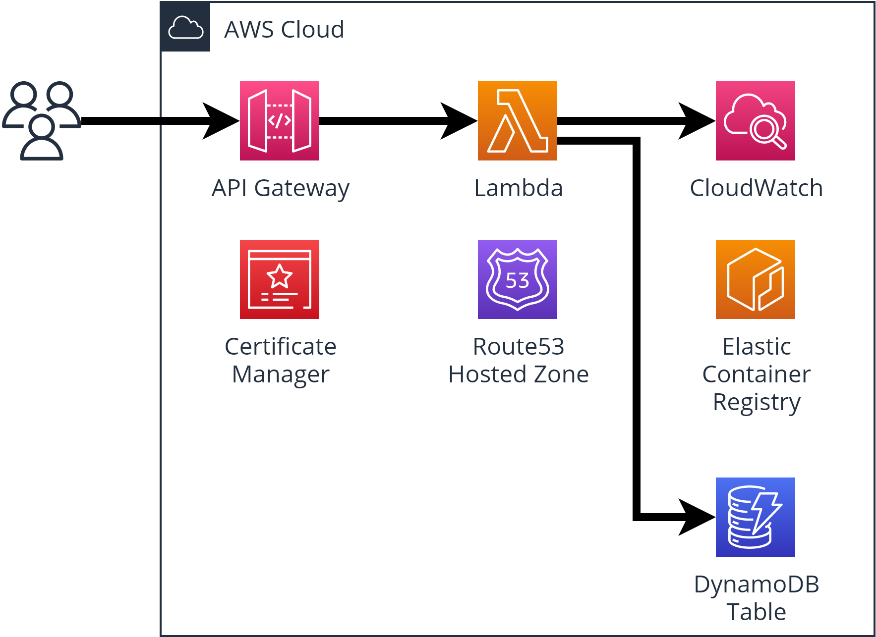
Lab: Hello World ASP.NET Core + DynamoDB (~15 min)
Instructions
See the README instructions for Workshop 02
Checkout branch
Deploy the application
Let’s explore the parts of the application together

Slide 58
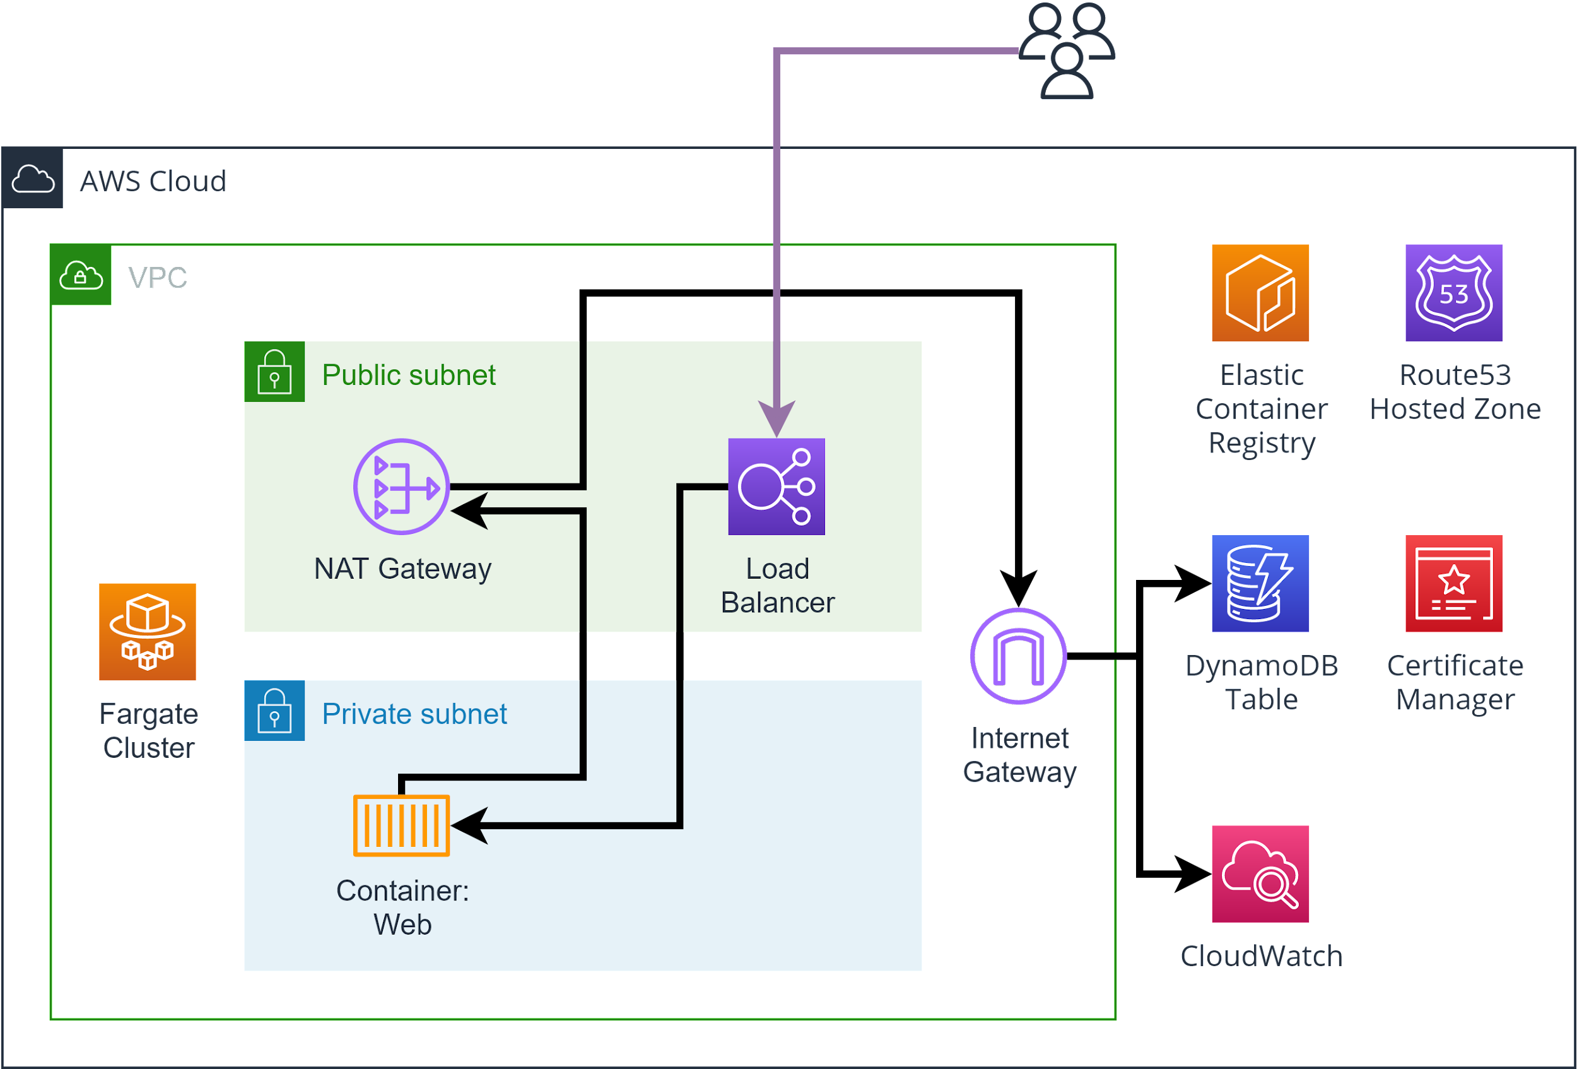
Lab: Hello ASP.NET Core + DynamoDB + Fargate (~15 min)
Instructions
See the README instructions for Workshop 03
Checkout branch
Deploy the VPC and application
Let’s explore the parts of the application together

Slide 59
Q&A

Slide 60
Let’s take a break!
Back at ##:##

Slide 61
VPC Network Communication

Slide 62
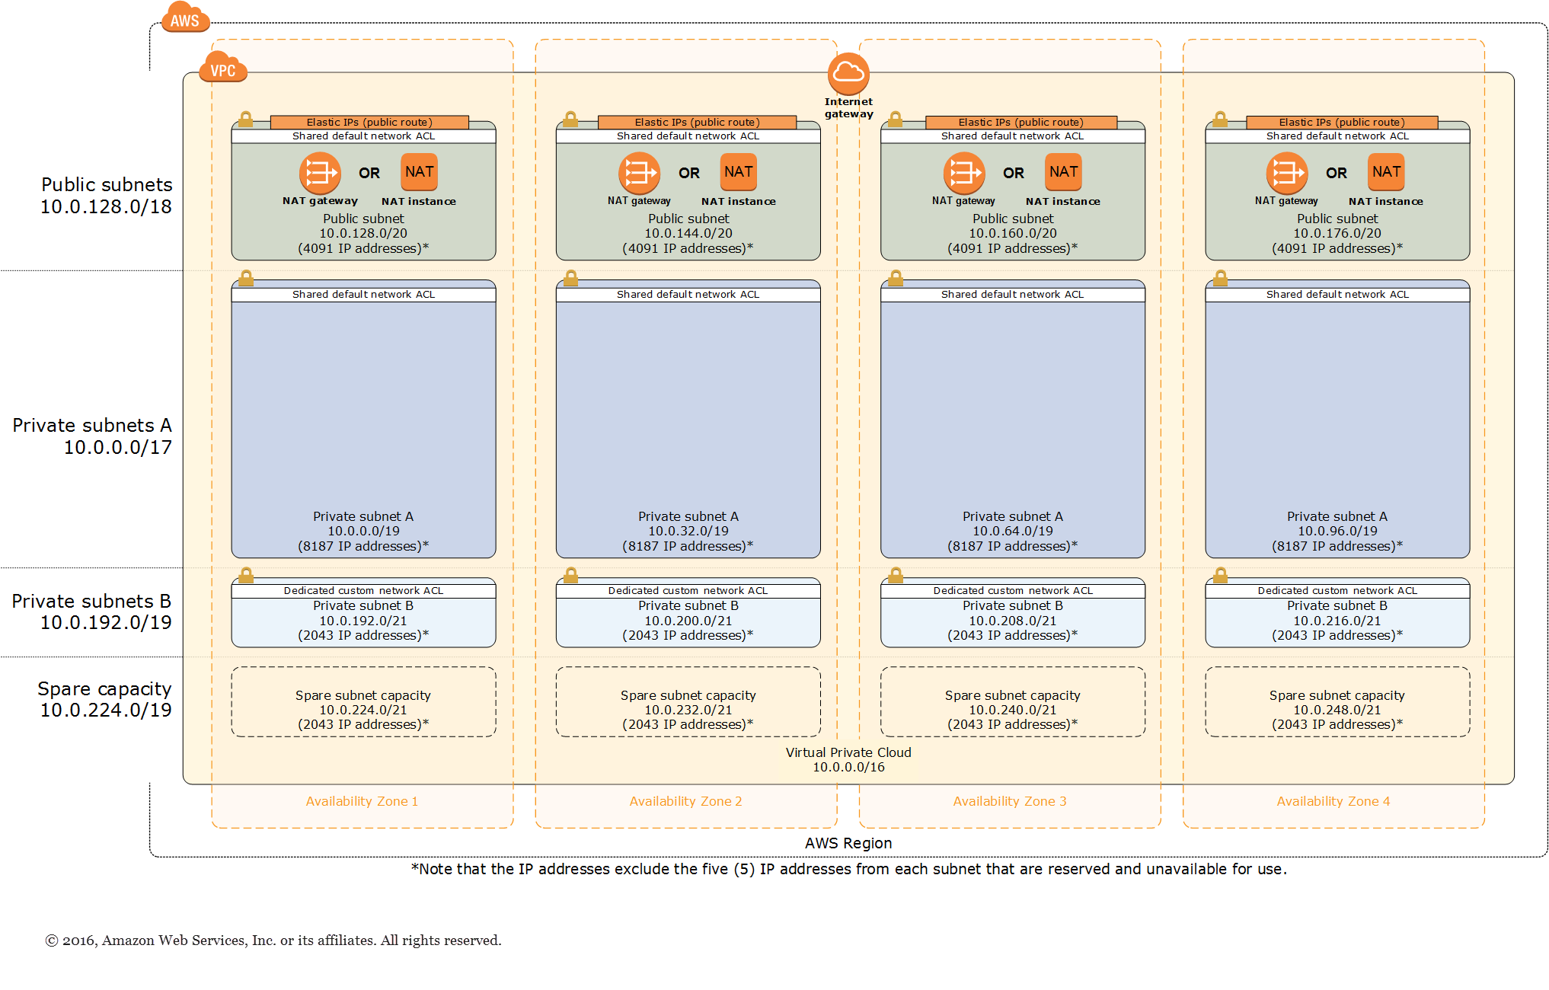
VPCs and Networking
https://aws.amazon.com/quickstart/architecture/vpc/

Slide 63
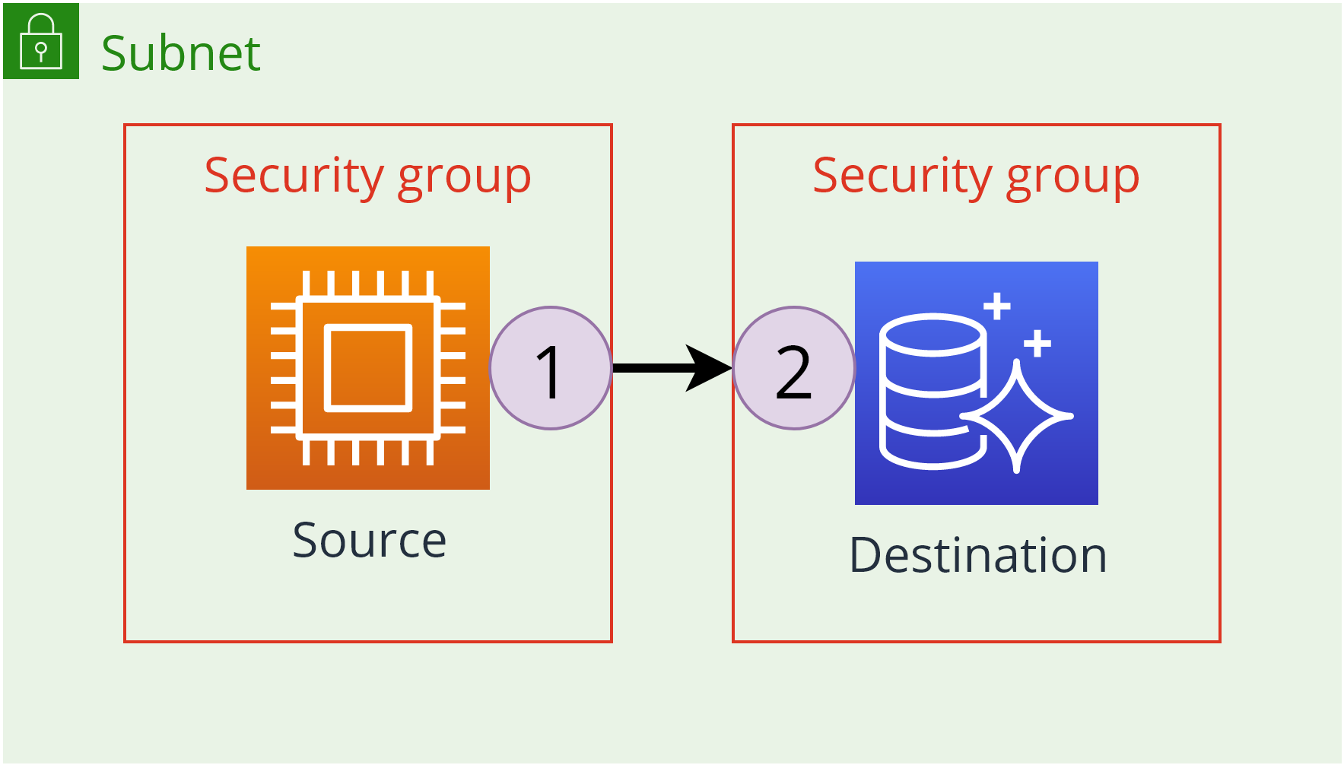
VPC Network Communication: Same Subnet

Slide 64
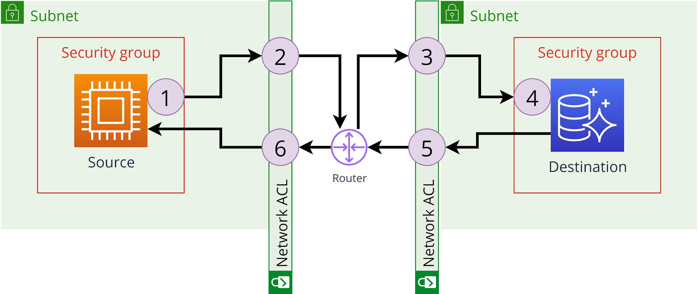
VPC Network Communication: Different Subnet

Slide 65
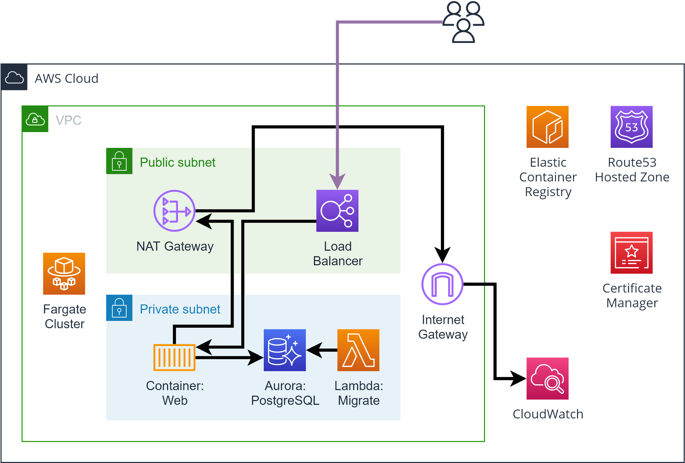
Lab: Relational Database Madness (~30 min)
Instructions
See the README instructions for Workshop 04
Checkout branch
Deploy the application
Let’s explore the parts of the application together

Slide 66
Q&A

Slide 67



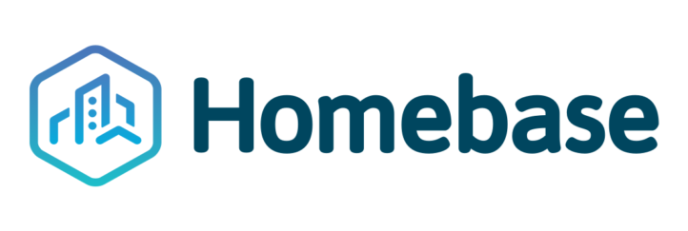













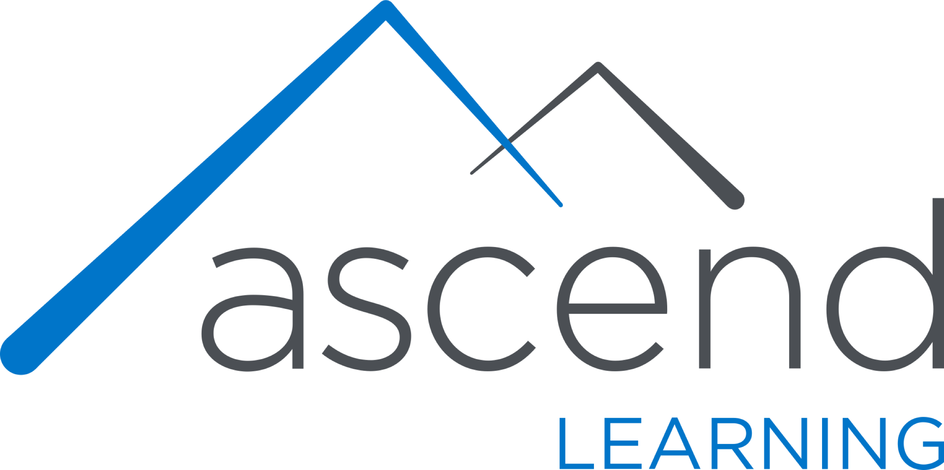









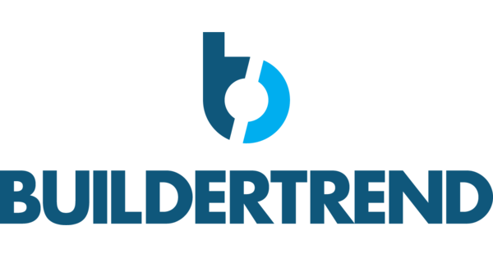






Titanium Sponsors
Platinum Sponsors
Gold Sponsors

Slide 68

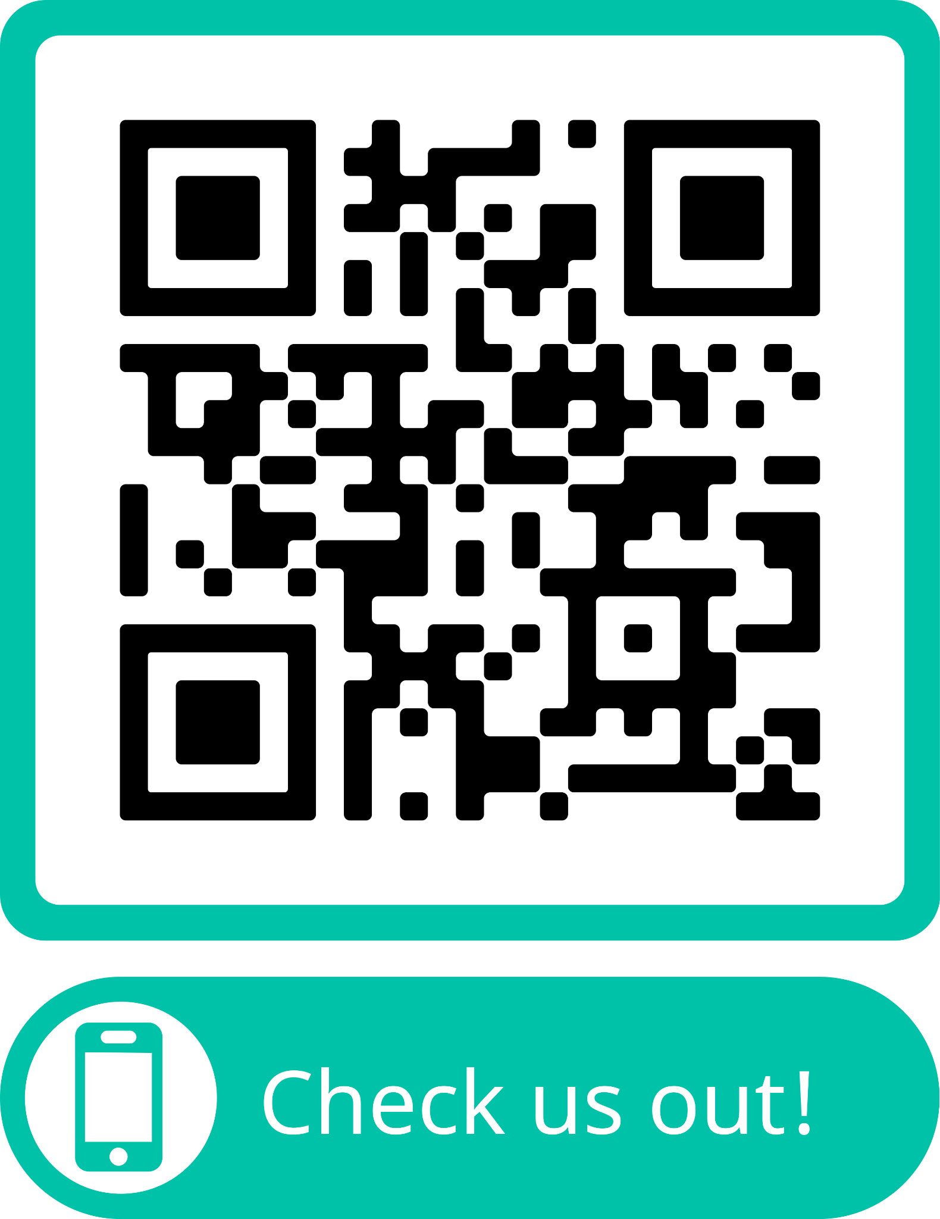

Slide 69


Let’s continue the conversation
Visit the Headspring booth!
www.headspring.com
garo@headspring.com patrickm@headspring.com
Notes:
Come visit us at the booth - we have swag, raffles, and learn more about our open job roles and our client projects
You can also learn more at headspring.com, or feel free to email me

